Slide 1
Detecting selection in protein-coding sequences
Stephanie J. Spielman, PhD
stephanie.spielman@temple.edu

Slide 2
All materials (and extra resources!) for my sessions live here:
sjspielman.org/lacawac2017

Slide 3
Natural selection leaves signatures of its activity in DNA
We can use phylogenetic codon models to study these signatures of selection:
Is my gene subject to positive selection?
Is my gene subject to lineage-specific positive selection?
Is my gene subject to shifts (intensification or relaxation) in selection pressure?
Are sites in my gene subject to pervasive positive selection?
Are sites in my gene subject to episodic positive selection?
Notes:
We study this information to gain insight into the biological and evolutionary processes that shape the natural world.
Hemagglutinin sequences have been studied to identify regions that are rapidly evolving, adaptive immune escape.
Shown in red. Identifying these sites contributes to rationale vaccine design so that antibodies can target the rapidly evolving regions.
Transition marked by several evolutionary patterns, such as genome reduction and reduced efficacy of NS.
Analysis here shows strength of NS is relaxed along bluer lineages, more stringent along red.
Consistent pattern where relaxed selection is commonly associated with endosymbiotic lineages.
How do we get this information? models.

Slide 4
Is my gene subject to positive selection?
Notes:
We study this information to gain insight into the biological and evolutionary processes that shape the natural world.
Hemagglutinin sequences have been studied to identify regions that are rapidly evolving, adaptive immune escape.
Shown in red. Identifying these sites contributes to rationale vaccine design so that antibodies can target the rapidly evolving regions.
Transition marked by several evolutionary patterns, such as genome reduction and reduced efficacy of NS.
Analysis here shows strength of NS is relaxed along bluer lineages, more stringent along red.
Consistent pattern where relaxed selection is commonly associated with endosymbiotic lineages.
How do we get this information? models.

Slide 5
Is my gene subject to lineage-specific positive selection?

Slide 6
Is my gene subject to shifts in selection pressure?

Slide 7
Are sites in my gene subject to pervasive positive selection?

Slide 8
Are sites in my gene subject to episodic positive selection?

Slide 9
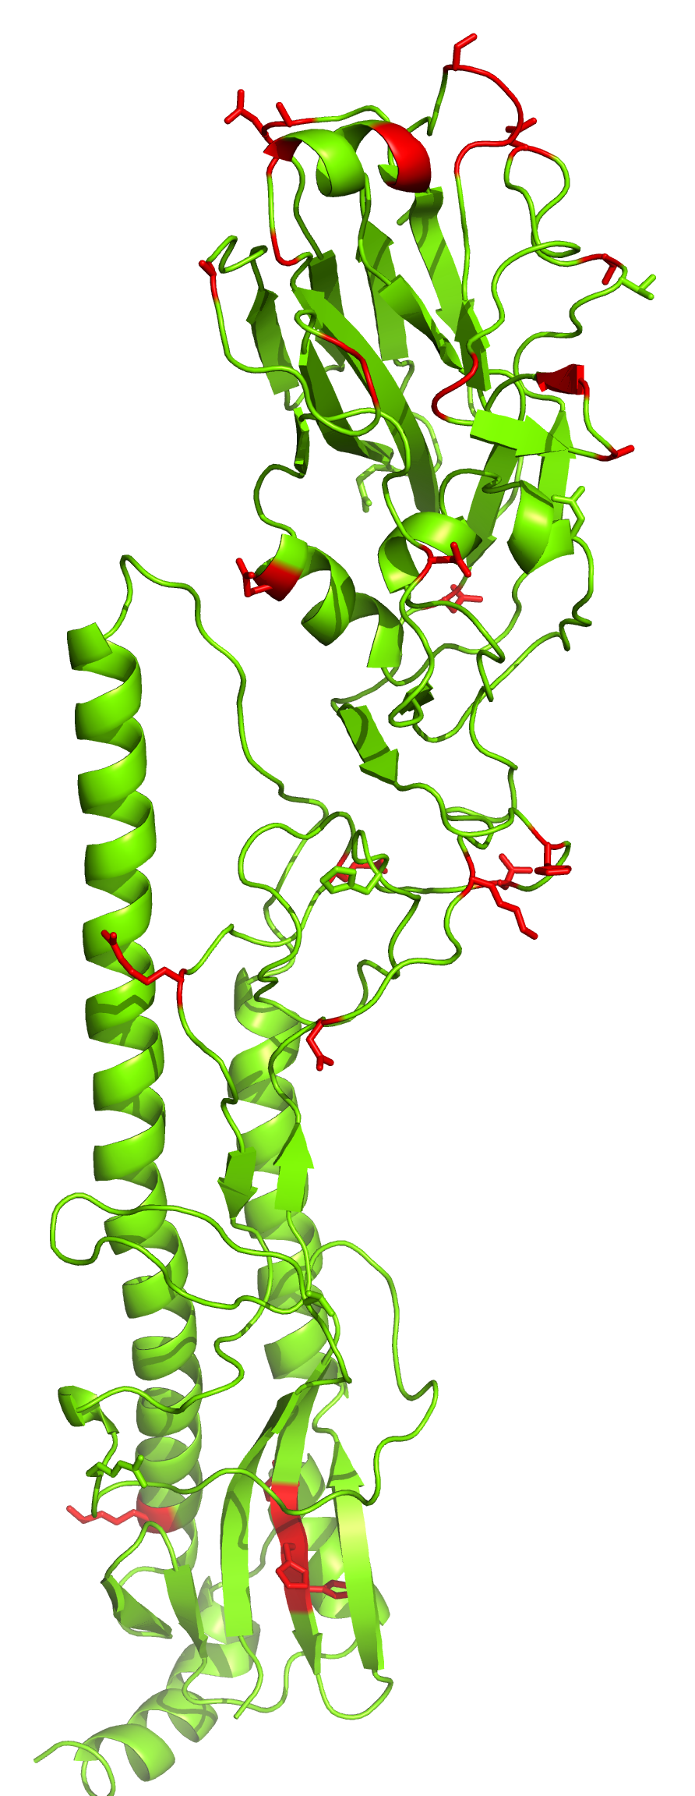
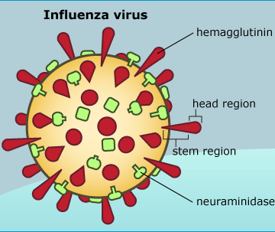
Example: Molecular evolution of pathogens
Modified from Meyer and Wilke Mol. Biol. Evol. 30: 36-44 (2013)
Notes:
We study this information to gain insight into the biological and evolutionary processes that shape the natural world.
Hemagglutinin sequences have been studied to identify regions that are rapidly evolving, adaptive immune escape.
Shown in red. Identifying these sites contributes to rationale vaccine design so that antibodies can target the rapidly evolving regions.
Transition marked by several evolutionary patterns, such as genome reduction and reduced efficacy of NS.
Analysis here shows strength of NS is relaxed along bluer lineages, more stringent along red.
Consistent pattern where relaxed selection is commonly associated with endosymbiotic lineages.
How do we get this information? models.

Slide 10
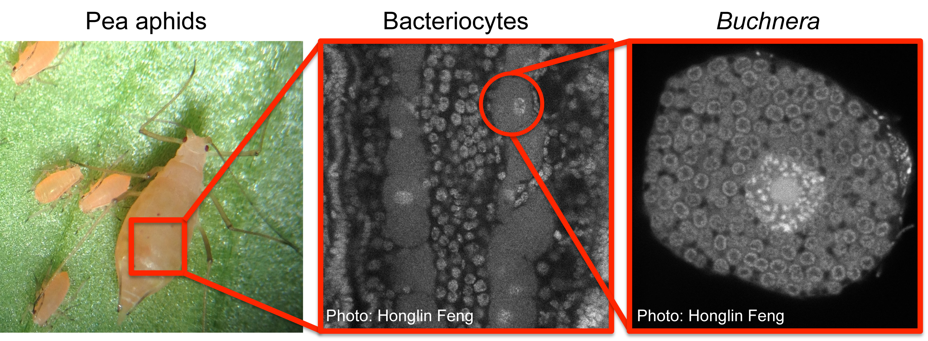
Example: Molecular evolution of major transitions
Wertheim et al. Mol. Biol. Evol. 32:820-832 (2015)

Slide 11
Example: Linking molecular evolution to life history evolution
High-performance fish vs. Sedentary fish
Faster mitochondrial evolution in high-performance fish than sedentary fish
Strohm, Gwiazdowski, and Hanner Gene 572:27-34 (2015).

Slide 12
Example: Linking molecular evolution to phenotypic evolution
Eel-specific insertions
Positive selection
Gruber et al. PLOS ONE 10(11): e0140972. 2015.

Slide 13
Example: Linking molecular evolution to environmental stimuli
Ultimately, by studying the genetic architecture of stress responsiveness in wild vertebrates, we can begin to bridge the gap between proximate studies of molecular mechanisms and ultimate studies of fitness consequences in the wild.
Hofmeister and Rubenstein. Ecology Letters 19:1219—1227. 2016.

Slide 14
The quick ‘n dirty of codon models

Slide 15
We fit models using a multiple sequence alignment and a corresponding phylogeny
23 612
PPARG_HUMAN CCAGAGTCCG CTGACCTCCG GGCCCTGAAA PPARG_XENLA CCCGAGTCGG CCGATCAGCG AGTCCTGAAA Q9I878_CHICK CCTGAATCTG CTGATCTGCG AGCGCTTAAG PPARG_MOUSE CCAGAGTCTG CTGATCTGCG AGCCCTGAAG
PPARG_RAT CCAGAGTCTG CTGATCTGCG AGCCCTGAAG PPARG_BOVIN CCAGAGTCTG CTGACCTCCG GGCCCTGAAG PPARG_MACMU CCAGAGTCCG CTGACCTCCG GGCCCTGAAA PPARG_RABIT CCCGAGTCTG CCGACCTCCG GGCCCTGAAG PPARB_XENLA CCA---GTGT CTGACTTGGA TGTTCTACAG

Slide 16
We generally use dN/dS-based codon models to infer selection
dN = nonsynonymous substitution rate
dS = synonymous substitution rate
AGT → CGT
M R
CGC → CGT
R R
dN/dS < 1 | Purifying selection
dN/dS ~ 1 | Neutral evolution
dN/dS > 1 | Positive selection

Slide 17
We model sequence evolution as a Markov process
A Markov Process has a specified set of states
Nucleotide: A C G T
Amino acid: A C D E F G H I K L M N P Q R S T V W Y
Codon: AAA, AAC, AAG, ..., TTT
Markov processes are memory-less
Transitions between states occur with a probability that depends only on the current state
Evolution acts on current genotype/phenotype, not on ancestral or future
Notes:
say time-reversible

Slide 18
We model sequence evolution as a Markov process
A Markov Process has a specified set of states.
Nucleotide: A C G T
Amino acid: A C D E F G H I K L M N P Q R S T V W Y
Codon: AAA, AAC, AAG, ..., TTT
Markov processes are memory-less
Transitions between states occur with a probability that depends only on the current state.
... T → A → G → T → C → A → G → ...
Time
Notes:
say time-reversible

Slide 19
We model sequence evolution as a Markov process
A Markov Process has a specified set of states.
Nucleotide: A C G T
Amino acid: A C D E F G H I K L M N P Q R S T V W Y
Codon: AAA, AAC, AAG, ..., TTT
Markov processes are memory-less
Transitions between states occur with a probability that depends only on the current state.
P(G|A)
P(G|A)
... T → A → G → T → C → A → G → ...
Time
Notes:
say time-reversible

Slide 20
From populations to Markov chains
time
Assumption that differences among sequences are fixed differences, i.e. substitutions

Slide 21
We generally use dN/dS models to infer selection
dN = nonsynonymous substitution rate
dS = synonymous substitution rate
AGT → CGT
M R
CGC → CGT
R R
dN/dS < 1 | Purifying selection
dN/dS ~ 1 | Neutral evolution
dN/dS > 1 | Positive selection

Slide 22
A codon model is a 61x61 matrix
AAA AAC AAG AAT ACA … TTT
AAA
AAC
AAG
AAT
ACA
…
TTT
AAA→ AAG
synonymous transition:
r_{AG} * F_{<G,AAG>}
AAG→ AAT
nonsynonymous change:
r_{GT} * ⍵ * F_{<T,AAT>}
ACA→ AAC
Rate = 0 when
2 nucleotide changes

Slide 23
These models are only suitable for intraspecific data and pathogens
Caution!

Slide 24
Using HyPhy to detect selection
Homepage: http://hyphy.org
Datamonkey webserver: http://datamonkey.org
New Datamonkey webserver: http://test.datamonkey.org

Slide 25
Methods we’ll look at today
Is my gene subject to positive selection sometime, somewhere? BUSTED
Is my gene subject to lineage-specific positive selection? aBSREL
Is my gene subject to shifts (intensification or relaxation) in selection pressure? RELAX
Are sites in my gene subject to pervasive positive selection? FEL
Are sites in my gene subject to episodic positive selection? MEME

